Slide 1
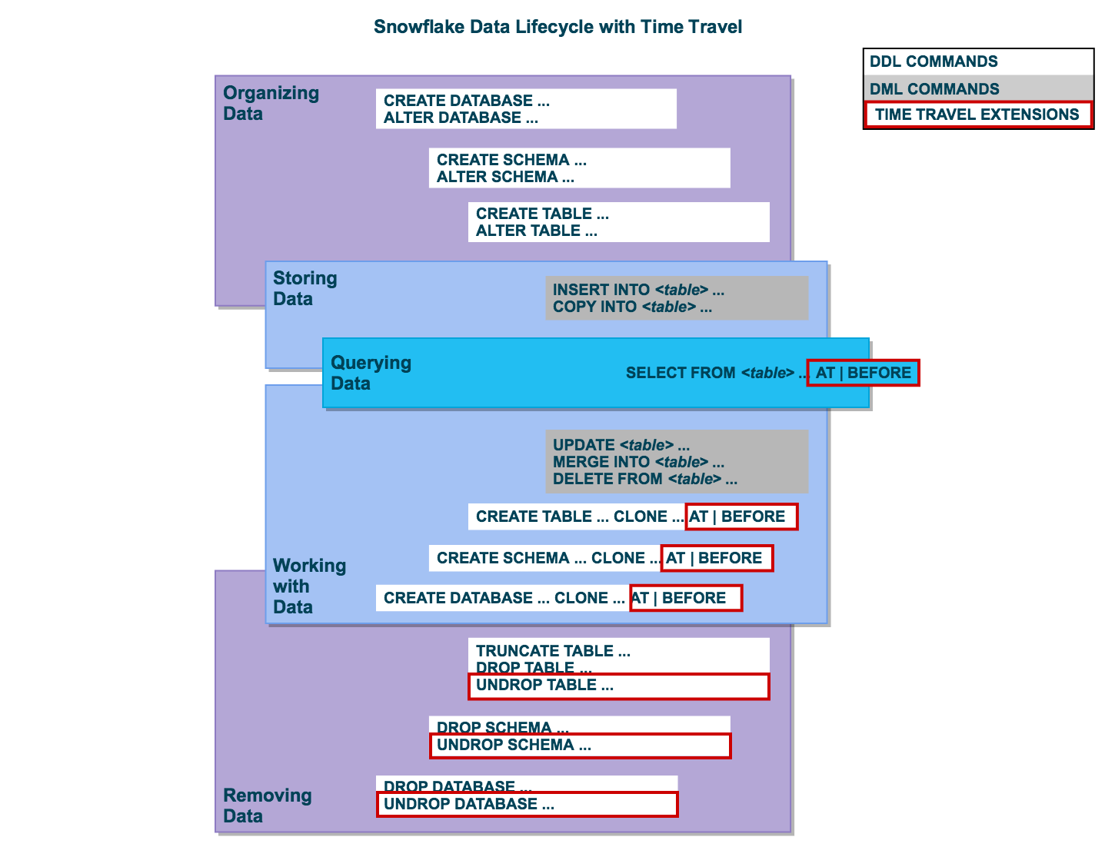
Snowflake – Time Travel
Time Travel SQL Constructs
AT / Before in SQL for object retrieval / access
Clone Command for data / object restoration
SQL Parameters – TIMESTAMP, OFFSET, STATEMENT

Slide 2
Snowflake – Time Travel
Examples :
select * from my_table at(timestamp => 'Mon, 01 May 2015 16:20:00 -0700'::timestamp);
select * from my_table at(offset => -60*5);
select * from my_table before(statement => '8e5d0ca9-005e-44e6-b858-a8f5b37c5726’);
create table restored_table clone my_table at(timestamp => 'Mon, 09 May 2015 01:01:00 +0300'::timestamp);
create schema restored_schema clone my_schema at(offset => -3600);
create database restored_db clone my_db before(statement => '8e5d0ca9-005e-44e6-b858-a8f5b37c5726')
Data Retention Period
The Standard Retention Period is 1 day / 24 Hours
Retention Period can be set to 0 on Account and Object Level (Database, Schema, Table) – TT Disabled
Enterprise Edition and Higher – Data Retention Period can be set to 0-90
Examples
create table mytable(col1 number, col2 date) data_retention_time_in_days=90;
alter table mytable set data_retention_time_in_days=30

Slide 3
Snowflake – Time Travel
Dropping And Restoring :
Create table my_sales_tab_ver1(id number,descr varchar(100));
Create table my_fin_tab_ver1(id number, currency varchar(100));
insert into MY_SALES_TAB_VER1 values (100,'Electronics'), (200, 'Furniture'), (300,'Foot Wear');
Drop Table my_sales_tab_ver1;
show tables history;
Create table my_sales_tab_ver1(id number);
insert into my_sales_tab_ver1 values (1111), (2222), (3333), (4444);
drop table my_sales_tab_ver1 ;
create table my_sales_tab_ver1 (c1 varchar);
show tables history;
alter table my_sales_tab_ver1 rename to my_sales_tab_ver3;
undrop table my_sales_tab_ver1 ;
show tables history;
alter table my_sales_tab_ver1 rename to my_sales_tab_ver2;
undrop table my_sales_tab_ver1 ;

Slide 4
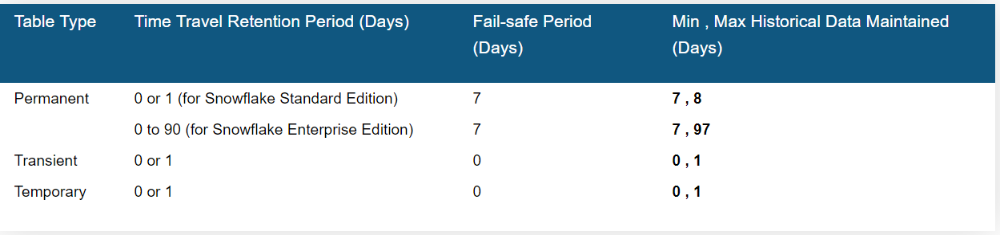
Snowflake – Time Travel
History – Dropped Objects
show tables history like 'load%' in mytestdb.myschema;
show schemas history in mytestdb;
show databases history;
Undrop
undrop table mytable;
undrop schema myschema;
undrop database mydatabase;
Storage Costs
Storage Fee charges for every 24 Hours

